Slide 1
U.S. HISTORY
Appendix E U.S. Topographical Map
PowerPoint Image Slideshow

Slide 2
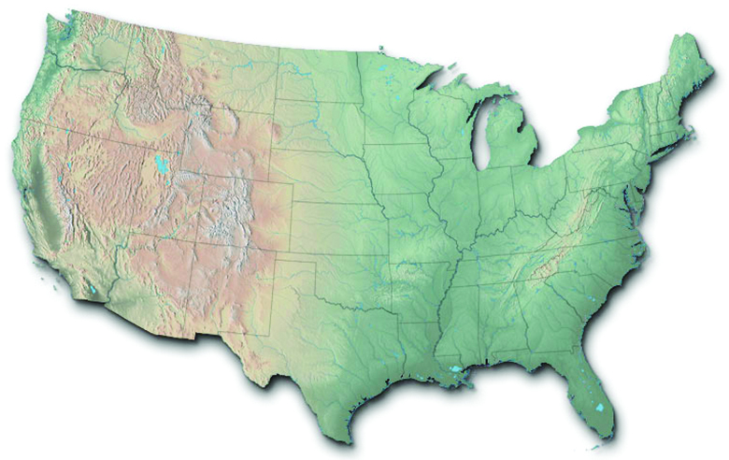
Figure E1

