Slide 1
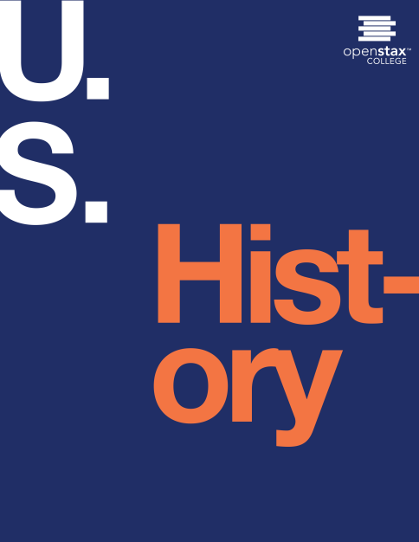
U.S. HISTORY
Chapter 14 Troubled Times: the Tumultuous 1850s
PowerPoint Image Slideshow

Slide 2
Figure 14.1
In Southern Chivalry: Argument versus Club’s (1856), by John Magee, South Carolinian Preston Brooks attacks Massachusetts senator Charles Sumner after his speech denouncing “border ruffians” pouring into Kansas from Missouri. For southerners, defending slavery meant defending southern honor.

Slide 3
Figure 14.2

Slide 4
Figure 14.3
This map shows the states and territories of the United States as they were in 1849–1850. (credit “User:Golbez”/Wikimedia Commons)

Slide 5
Figure 14.4
This 1850 print, Scene in Uncle Sam’s Senate, depicts Mississippi senator Henry S. Foote taking aim at Missouri senator Thomas Hart Benton. In the print, Benton declares: “Get out of the way, and let the assassin fire! Let the scoundrel use his weapon! I have no arm’s! I did not come here to assassinate!” Foote responds, “I only meant to defend myself!” (credit: Library of Congress)

Slide 6
Figure 14.5
This map shows the states and territories of the United States as they were from 1850 to March 1853. (credit “User:Golbez”/Wikimedia Commons)

Slide 7
Figure 14.6
This 1851 poster, written by Boston abolitionist Theodore Parker, warned that any black person, free or slave, risked kidnapping by slave-catchers.

Slide 8
Figure 14.7
This full-length portrait of Harriet Tubman hangs in the National Portrait Gallery of the Smithsonian.

Slide 9
Figure 14.8
Anthony Burns, drawn ca. 1855 by an artist identified only as “Barry,” shows a portrait of the fugitive slave surrounded by scenes from his life, including his escape from Virginia, his arrest in Boston, and his address to the court.

Slide 10
Figure 14.9
This drawing from Uncle Tom’s Cabin, captioned “Eliza comes to tell Uncle Tom that he is sold, and that she is running away to save her child,” illustrates the ways in which Harriet Beecher Stowe’s antislavery novel bolstered abolitionists’ arguments against slavery.

Slide 11
Figure 14.10
This photograph shows Harriet Beecher Stowe, the author of Uncle Tom’s Cabin, in 1852. Stowe’s work was an inspiration not only to abolitionists, but also to those who believed that women could play a significant role in upholding the nation’s morality and shaping public opinion.

Slide 12
Figure 14.11
In this 1850 political cartoon, the artist takes aim at abolitionists, the Free-Soil Party, Southern states’ rights activists, and others he believes risk the health of the Union.

Slide 13
Figure 14.12
This 1855 map shows the new territories of Kansas and Nebraska, complete with proposed routes of the transcontinental railroad.

Slide 14
Figure 14.13
This full-page editorial ran in the Free-Soiler Kansas Tribune on September 15, 1855, the day Kansas’ Act to Punish Offences against Slave Property of 1855 went into effect. This law made it punishable by death to aid or abet a fugitive slave, and it called for punishment of no less than two years for anyone who might: “print, publish, write, circulate, or cause to be introduced into this Territory . . . [any materials] . . . containing any denial of the right of persons to hold slaves in this Territory.”

Slide 15
Figure 14.14
This undated image shows the aftermath of the sacking of Lawrence, Kansas, by border ruffians. Shown are the ruins of the Free State Hotel.

Slide 16
Figure 14.15
This 1856 political cartoon, Forcing Slavery Down the Throat of a Free Soiler, by John Magee, shows Republican resentment of the Democratic platform—here represented as an actual platform—of expanding slavery into new western territories.

Slide 17
Figure 14.16
This 1888 portrait by Louis Schultze shows Dred Scott, who fought for his freedom through the American court system.

Slide 18
Figure 14.17
In 1858, Abraham Lincoln (a) debated Stephen Douglas (b) seven times in the Illinois race for the U.S. Senate. Although Douglas won the seat, the debates propelled Lincoln into the national political spotlight.

Slide 19
Figure 14.18
John Brown, shown here in a photograph from 1859, was a radical abolitionist who advocated the violent overthrow of slavery.

Slide 20
Figure 14.19
John Brown’s raid on Harpers Ferry represented the radical abolitionist’s attempt to start a revolt that would ultimately end slavery. This 1859 illustration, captioned “Harper’s Ferry insurrection—Interior of the Engine- House, just before the gate is broken down by the storming party—Col. Washington and his associates as captives, held by Brown as hostages,” is from Frank Leslie’s Illustrated Magazine. Do you think this image represents a southern or northern version of the raid? How are the characters in the scene depicted?

Slide 21
Figure 14.20
The national game. Three “outs” and one “run” (1860), by Currier and Ives, shows the two Democratic candidates and one Constitutional Union candidate who lost the 1860 election to Republican Lincoln, shown at right.

Slide 22
Figure 14.21
This map shows the disposition of electoral votes for the election of 1860. The votes were divided along almost perfect sectional lines.

