Slide 1
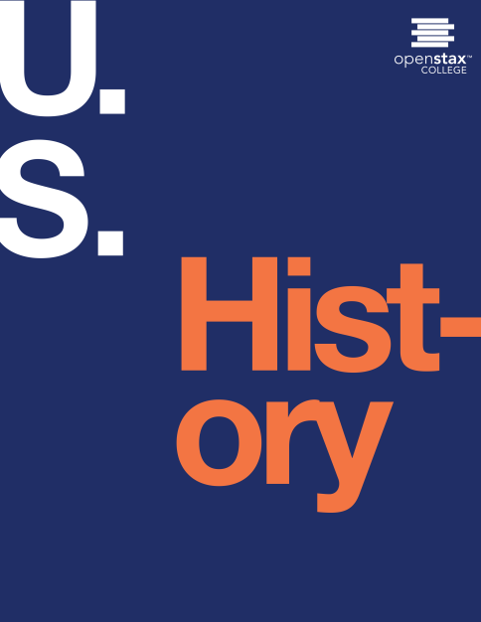
U.S. History
Chapter 28 Post-War Prosperity and Cold War Fears, 1945-1960
PowerPoint Image Slideshow

Slide 2
Figure 28.1
Is This Tomorrow? warned Americans about the potential horrors of living under a Communist dictatorship. Postwar propaganda such as this comic book, the cover of which showed invading Russians attacking Americans and the U.S. flag in flames, served to drum up fear during the Cold War.

Slide 3
Figure 28.2
(credit: “1953”: modification of work by Library of Congress)

Slide 4
Figure 28.3
President Franklin D. Roosevelt signed the Servicemen’s Readjustment Act, or GI Bill, on June 22, 1944, just weeks after the Allied invasion of Normandy, France, and more than a year before the end of the war.

Slide 5
Figure 28.4
At the postwar conference in Potsdam, Germany, Harry Truman stands between Joseph Stalin (right) and Clement Atlee (left). Atlee became prime minister of Great Britain, replacing Winston Churchill, while the conference was taking place.

Slide 6
Figure 28.5
During World War II, George C. Marshall was responsible for expanding the 189,000-member U.S. Army into a modern, fighting force of eight million by 1942. As Secretary of State under Truman, he proposed the European Recovery Program to aid European economies struggling after the war.

Slide 7
Figure 28.6
American C-47 transport planes (a) are loaded with staged supplies at a French airport before taking off for Berlin. Residents of Berlin wait for a U.S. plane (b) carrying needed supplies to land at Templehof Airport in the American sector of the city.

Slide 8
Figure 28.7
After the initial invasion of South Korea by the North Korean People’s Democratic Army, the United Nations established a defensive line in the southern part of the country. The landing at Inchon in September reversed the tide of the war and allowed UN forces under General Douglas MacArthur to retake the city of Seoul, which had fallen to North Korean troops in the early days of the war.

Slide 9
Figure 28.8
Senator Joseph McCarthy (left) consults with Roy Cohn (right) during the Army-McCarthy hearings. Cohn, a lawyer who worked for McCarthy, was responsible for investigating State Department libraries overseas for “subversive” books.

Slide 10
Figure 28.9
Dwight D. Eisenhower was the perfect presidential candidate in 1952. He had never before run for office or even cast a vote, and thus had no political record to be challenged or criticized.

Slide 11
Figure 28.10
The above map shows the resounding victory of Dwight D. Eisenhower over Adlai Stevenson in the 1952 election. Stevenson carried only the South, where whites had voted for Democratic Party candidates since the time of the Civil War.

Slide 12
Figure 28.11
The launch of the Soviet satellite Sputnik frightened many in the United States, who feared that Soviet technology had surpassed their own. To calm these fears, Americans domesticated Sputnik, creating children’s games based on it and using its shape as a decorative motif.

Slide 13
Figure 28.12
This aerial view of Levittown, Pennsylvania, reveals acres of standardized homes. The roads were curved to prevent cars from speeding through the residential community that was home to many young families.

Slide 14
Figure 28.13
In the late 1940s, a network of newly constructed highways connected suburban Long Island with Manhattan. The nation’s new road network also served a military purpose; interstate highways made it easier to deploy troops in the event of a national emergency.

Slide 15
Figure 28.14
The band Bill Haley and His Comets (a) was among the first to launch the new genre of rock and roll. Their hit song “Rock Around the Clock” supposedly caused some teens to break into violent behavior when they heard it. Chuck Berry (b) was a performer who combined rhythm and blues and rock and roll. He dazzled crowds with guitar solos and electrifying performances.

Slide 16
Figure 28.15
One of the original Hollywood Ten, director Edward Dmytryk publicly announced he had once been a Communist and, in April 1951, answered questions and “named names” before the House Committee on Un- American Activities.

Slide 17
Figure 28.16
An American family relaxes in front of their television set in 1958. Many gathered not only to watch the programming but also to eat dinner. The marketing of small folding tray tables and frozen “TV dinners” encouraged such behavior.

Slide 18
Figure 28.17
Baseball legend Jackie Robinson (a) was active in the civil rights movement. He served on the NAACP’s board of directors and helped to found an African American-owned bank. Alice Coachman (b), who competed in track and field at Tuskegee University, was the first black woman to win an Olympic gold medal.

Slide 19
Figure 28.18
This map shows those states in which racial segregation in public education was required by law before the 1954 Brown v. Board of Education decision. In 1960, four years later, fewer than 10 percent of southern African American students attended the same schools as white students.

Slide 20
Figure 28.19
In 1956, NAACP leaders (from left to right) Henry L. Moon, Roy Wilkins, Herbert Hill, and Thurgood Marshall present a new poster in the campaign against southern white racism. Marshall successfully argued the landmark case Brown v. Board of Education (1954) before the U.S. Supreme Court and later became the court’s first African American justice.

Slide 21
Figure 28.20
In 1957, U.S. soldiers from the 101st Airborne were called in to escort the Little Rock Nine into and around formerly all-white Central High School in Little Rock, Arkansas.

