Slide 1
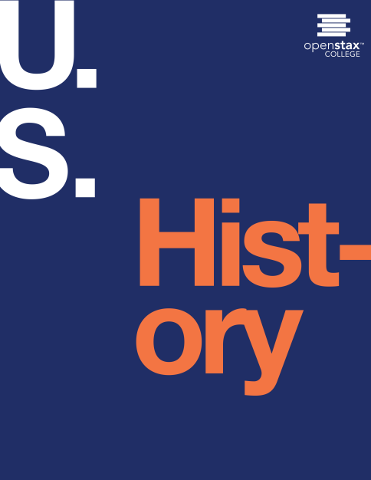
U.S. History
Chapter 26 Franklin Roosevelt and the New Deal, 1932-1941
PowerPoint Image Slideshow

Slide 2
Figure 26.1
President Roosevelt’s Federal One Project allowed thousands of artists to create public art. This initiative was a response to the Great Depression as part of the Works Project Administration, and much of the public art in cities today date from this era. New Deal by Charles Wells can be found in the Clarkson S. Fisher Federal Building and U.S. Courthouse in Trenton, New Jersey. (credit: modification of work by Library of Congress)

Slide 3
Figure 26.2

Slide 4
Figure 26.3
Franklin Roosevelt brought a new feeling of optimism and possibility to a country that was beaten down by hardship. His enthusiasm was in counterpoint to Herbert Hoover’s discouraging last year in office.

Slide 5
Figure 26.4
Roosevelt’s inauguration was truly a day of new beginnings for the country. The sun breaking through the clouds as he was being sworn in became a metaphor for the hope that people felt at his presidency.

Slide 6
Figure 26.5
Roosevelt’s “fireside chats” provided an opportunity for him to speak directly to the American people, and the people were happy to listen. These radio addresses, commemorated at the Franklin D. Roosevelt Memorial in Washington, DC, with this bronze sculpture by George Segal, contributed to Roosevelt’s tremendous popularity. (credit: Koshy Koshy)

Slide 7
Figure 26.6
The CCC put hundreds of thousands of men to work on environmental projects around the country. Some call it the beginning of the modern environmentalist movement in the United States.

Slide 8
Figure 26.7
Sharecroppers and tenant farmers suffered enormously during the Great Depression. The STFU was created to help alleviate this suffering, but many farmers ending up taking to the road, along with other Dust Bowl refugees, on their way to California.

Slide 9
Figure 26.8
Consumers were encouraged to buy from companies displaying the Blue Eagle (a), the logo signifying compliance with the new NRA regulations. With talons gripping a gear, representing industry, and lightning bolts, representing power, the eagle (b) was intended to be a symbol of economic recovery.

Slide 10
Figure 26.9
The TVA helped a struggling part of the country through the creation of jobs, and flood control and reforestation programs. The Wilson Dam, shown here, is one of nine TVA dams on the Tennessee River. (credit: United States Geological Survey)

Slide 11
Figure 26.10
Roosevelt used previously unheard of levels of government power in his attempt to push the country out of the Great Depression, as artist Joseph Parrish depicts here in this 1937 Chicago Tribune cartoon. While critics on the left felt that he had not done enough, critics on the right felt that his use of power was frighteningly close to fascism and socialism.

Slide 12
Figure 26.11
Huey P. Long was a charismatic populist and governor of Louisiana from 1928 to 1932. In 1932, he became a member of the U.S. Senate and would have been a serious rival for Roosevelt in the 1936 presidential election if his life had not been cut short by an assassin’s bullet.

Slide 13
Figure 26.12
Painted by artists funded by the Federal One Project, this section of Ohio, a mural located in the Bellevue, Ohio post office, illustrates a busy industrial scene. Artists painted the communities where they lived, thus creating visions of farms, factories, urban life, harvest celebrations, and more that still reflect the life and work of that era. (credit: Works Progress Administration)

Slide 14
Figure 26.13
This photo of Eleanor Roosevelt and Mary McLeod Bethune (second from left) was taken at the opening of Midway Hall, a federal building to house female African American government workers. Bethune was sometimes criticized for working with those in power, but her willingness to build alliances contributed to success in raising money and support for her causes.

Slide 15
Figure 26.14
After leaving her post as head of the Women’s Division of the Democratic Party, Molly Dewson (a) later accepted an appointment to the Social Security Board, working with fellow board members Arthur J. Altmeyer and George E. Bigge, shown here in 1937. Another influential advisor to President Franklin Roosevelt was Frances Perkins (b), who, as U.S. Secretary of Labor, graced the cover of Time magazine on August 14, 1933.

Slide 16
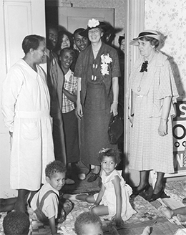
Figure 26.15
Eleanor Roosevelt travelled the country to promote New Deal programs. Here she visits a WPA nursery school in Des Moines, Iowa, on June 8, 1936. (credit: FDR Presidential Library & Museum)

