Slide 1
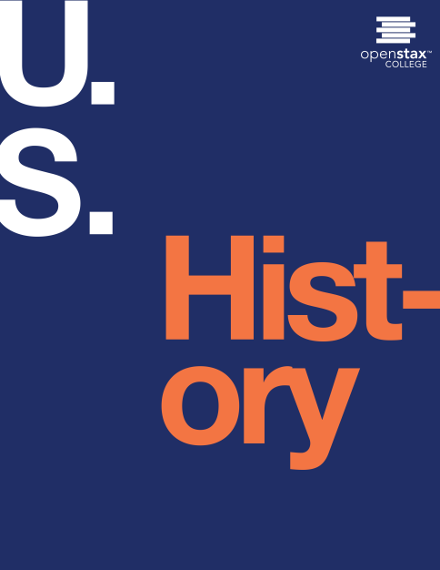
U.S. HISTORY
Chapter 18 Industrialization and the Rise of Big Business, 1870-1900
PowerPoint Image Slideshow

Slide 2
Figure 18.1
The Electrical Building, constructed in 1892 for the World’s Columbian Exposition, included displays from General Electric and Westinghouse, and introduced the American public to alternating current and neon lights. The Chicago World’s Fair, as the universal exposition was more commonly known, featured architecture, inventions, and design, serving as both a showcase for and an influence on the country’s optimism about the Industrial Age.

Slide 3
Figure 18.2

Slide 4
Figure 18.3
Advertisements of the late nineteenth century promoted the higher quality and lower prices that people could expect from new inventions. Here, a knitting factory promotes the fact that its machines make seamless hose, while still acknowledging the traditional role of women in the garment industry, from grandmothers who used to sew by hand to young women who now used machines.

Slide 5
Figure 18.4
Alexander Graham Bell’s patent of the telephone was one of almost 700,000 U.S. patents issued between 1850 and 1900. Although the patent itself was only six pages long, including two pages of illustrations, it proved to be one of the most contested and profitable of the nineteenth century. (credit: U.S. National Archives and Records Administration)

Slide 6
Figure 18.5
Thomas Alva Edison was the quintessential inventor of the era, with a passion for new ideas and over one thousand patents to his name. Seen here with his incandescent light bulb, which he invented in 1879, Edison produced many inventions that subsequently transformed the country and the world.

Slide 7
Figure 18.6
“The Great Race for the Western Stakes,” a Currier & Ives lithograph from 1870, depicts one of Cornelius Vanderbilt’s rare failed attempts at further consolidating his railroad empire, when he lost his 1866–1868 battle with James Fisk, Jay Gould, and Daniel Drew for control of the Erie Railway Company.

Slide 8
Figure 18.7
Andrew Carnegie made his fortune in steel at such factories as the Carnegie Steel Works located in Youngstown, Ohio, where new technologies allowed the strong metal to be used in far more applications than ever before. Carnegie’s empire grew to include iron ore mines, furnaces, mills, and steel works companies.

Slide 9
Figure 18.8
Based on a book by Horatio Alger, District Messenger Boy was a board game where players could achieve the ultimate goal of material success. Alger wrote hundreds of books on a common theme: A poor but hardworking boy can get ahead and make his fortune through a combination of “luck and pluck.”

Slide 10
Figure 18.9
John D. Rockefeller, like Carnegie, grew from modest means to a vast fortune. Unlike Carnegie, however, his business practices were often predatory and aggressive. This cartoon from the era shows how his conglomerate, Standard Oil, was perceived by progressive reformers and other critics.

Slide 11
Figure 18.10
A photographer took this image of children working in a New York glass factory at midnight. There, as in countless other factories around the country, children worked around the clock in difficult and dangerous conditions.

Slide 12
Figure 18.11
This engraving of the “Blockade of Engines at Martinsburg, West Virginia” appeared on the front cover of Harper’s Weekly on August 11, 1877, while the Great Railroad Strike was still underway..

Slide 13
Figure 18.12
The Haymarket affair, as it was known, began as a rally for the eight-hour workday. But when police broke it up, someone threw a bomb into the crowd, causing mayhem. The organizers of the rally, although not responsible, were sentenced to death. The affair and subsequent hangings struck a harsh blow against organized labor.

Slide 14
Figure 18.13
This poster invited workers to a meeting denouncing the violence at the labor rally earlier in the week. Note that the invitation is written in both English and German, evidence of the large role that the immigrant population played in the labor movement.

Slide 15
Figure 18.14
In this photo of the Pullman Strike of 1894, the Illinois National Guard and striking workers face off in front of a railroad building.

Slide 16
Figure 18.15
This page from the Sears, Roebuck & Co. catalog illustrates how luxuries that would only belong to wealthy city dwellers were now available by mail order to those all around the country.

Slide 17
Figure 18.16
This typewriter advertisement, like others of the era, tried to lure customers by offering a new model.

